Slide 1

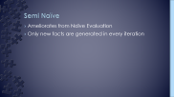

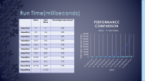
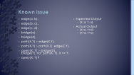





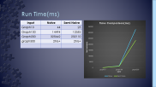



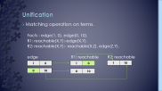



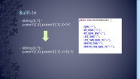





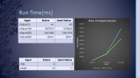



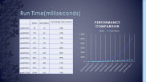







Slide 2
Project – CoDalog

Slide 3
Content
What is CoDalog
Components
Parser
Engine
Unification
Extensions
Performance Evaluation

Slide 4
CoDalog
Datalog Compiler + Evaluation Engine
Developed in Core Java
Support some extensions to Datalog

Slide 5
Components
Parser
Engine
Naïve
Semi Naive
Extensions
Built-In
Negation

Slide 6
Flow Diagram
Parser
Tokenize Input
Validate Input
Engine
Generate new Facts
Evaluate Queries
Query Results
P.output
Stratify Program

Slide 7
Parser
Read input file, P.cdl , in tokens.
Checks for Syntax errors
If any, writes them in error file(P.err)
Identifies different elements of program
Facts
Rules
Query
Builds Preliminary Database
EDB(facts from P.cdl)
IDB(rules from P.cdl)

Slide 8
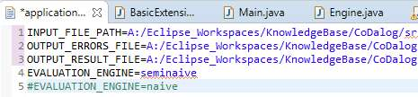
Engine
Generate new facts.
Evaluate Queries.
Bottom Up Evaluation :
Naïve
Semi-Naïve
Reports semantics errors, if any.

Slide 9
Naïve Evaluation
Fixed point Evaluation
Evaluates previously derived facts in each iteration

Slide 10
Semi Naïve
Ameliorates from Naïve Evaluation
Only new facts are generated in every iteration

Slide 11
Unification
Matching operation on terms.
Facts : edge(1, 0), edge(0, 10).
R1: reachable(X,Y):-edge(X,Y).
R2: reachable(X,Y):- reachable(X,Z), edge(Z,Y).
edge R1: reachable R2: reachable
1 | 0
1 | 0
1 | 10
0 | 10
0 | 10

Slide 12
Extensions
Built-In
Negation

Slide 13
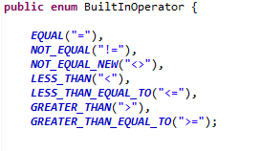
Built-In
sibling(X,Y):- parent(Z,X),parent(Z,Y),X<>Y.
sibling(X,Y):- parent(Z,X),parent(Z,Y),<>(X,Y)

Slide 14
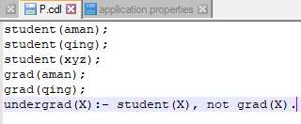
Negation
Stratify Rules
Depth First Search
Checks any –ve cycle.

Slide 15
Performance Evaluation
Error Handling
P.err (Syntax Errors)
Runtime Error ( stratification)
Correctness
Compare result with known valid outputs
Scalability
Currently uses in-memory database

Slide 16
Run Time(milliseconds)
 | Naïve | Semi Naïve | Percentage Improvement
graph10.pl | 45 | 16 | 64%
graph20.pl | 129 | 63 | 51%
graph30.pl | 310 | 94 | 70%
graph40.pl | 531 | 156 | 71%
graph50.pl | 1016 | 203 | 80%
graph60.pl | 1719 | 266 | 85%
graph70.pl | 2813 | 313 | 89%
graph80.pl | 4531 | 428 | 91%
graph90.pl | 7016 | 551 | 92%
graph100.pl | 10344 | 656 | 94%

Slide 17
Run Time(milliseconds)
 | Naïve | Semi Naïve | Percentage Improvement
clique10.pl | 94 | 47 | 50%
clique20.pl | 375 | 158 | 58%
clique30.pl | 1485 | 234 | 84%
clique40.pl | 4949 | 548 | 89%
clique50.pl | 13564 | 954 | 93%
clique60.pl | 36453 | 1708 | 95%
clique70.pl | 75396 | 2829 | 96%
clique80.pl | 149487 | 4719 | 97%
clique90.pl | 238954 | 7876 | 97%
clique100.pl | 417966 | 10907 | 97%
Clique200.pl | - | 211029 | -

Slide 18
Merci!

